Slide 1
PL PRACTICE
JOSÉ LUIS CUMBRERA SÁNCHEZ
TEODORO MARTÍNEZ MÁRQUEZ

Slide 2
Structure:
int main(){
variable declarations;
assignments;
printf intruction;
  if, if-else, while sentences;
  return 0;
}

Slide 3
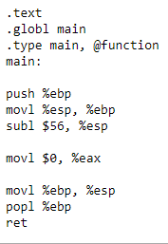
Variables.
We accept integers, vectors and pointers.
int main(){
int a,b,c;
int v[10];
int ***p;
return 0;
}

Slide 4
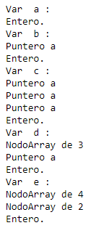

Internal definitions.
(uncomment Nodo.Escribir)
int main(){
int a,*b, ***c, *d[3], e[4][2];
return 0;
}

Slide 5
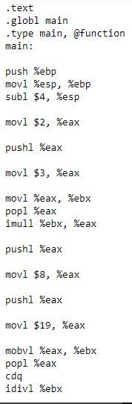
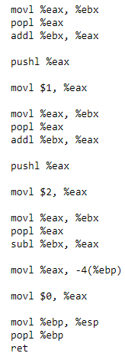
Assignment
int main(){
int a;
a=2*3+8/19+1-2;
return 0;
}

Slide 6
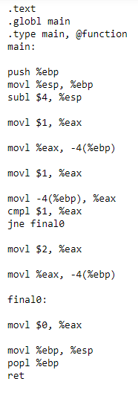
If sentence.
int main(){
int a;
a=1;
if(a==1){
a=2;
}
return 0;
}

Slide 7
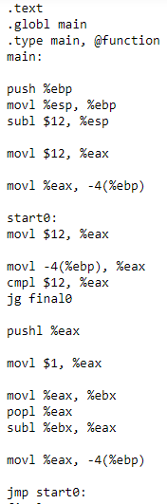
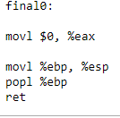
while sentence.
int main(){
int a,b,c;
a=12;
while(a<=12){
a=a-1;
}
return 0;
}

Slide 8
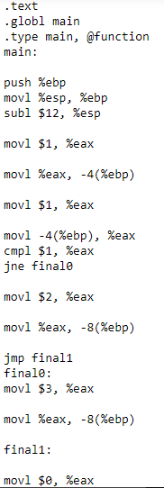

If-else sentence.
int main(){
int a,b,c;
a=1;
if(a==1){
b=2;
}else{
b=3;
}
return 0;
}

Slide 9
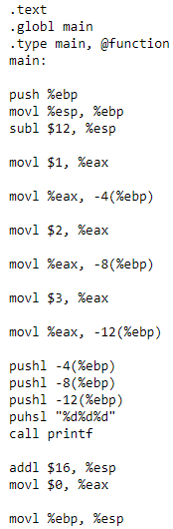

Printf.
int main(){
int a,b,c;
a=1;
b=2;
c=3;
printf("%d %d %d",a,b,c);
return 0;
}

Slide 10
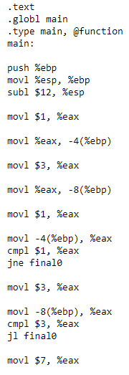
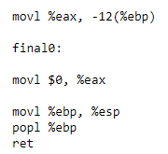
If with &&.
int main(){
int a,b,c;
a=1;
b=3;
if(a==1 && b>=3){
c=7;
}
return 0;
}

Slide 11
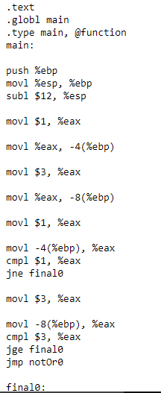
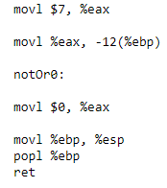
If with ||.
int main(){
int a,b,c;
a=1;
b=3;
if(a==1 || b>=3){
c=7;
}
return 0;
}

Slide 12
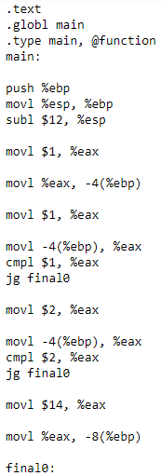
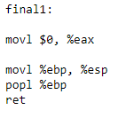
If inside an if.
int main(){
int a,b,c;
a=1;
if(a<=1){
if(a<=2){
b=14;
}
}
return 0;
}

